Slide 1
1150 Programming Logic and Design
Chapter 2, first part
Flow Control with if elif else statements

Slide 2
Last Week
Variables
Data types: string, int and float
Print and input

Slide 3
Review – homework from last class

Slide 4
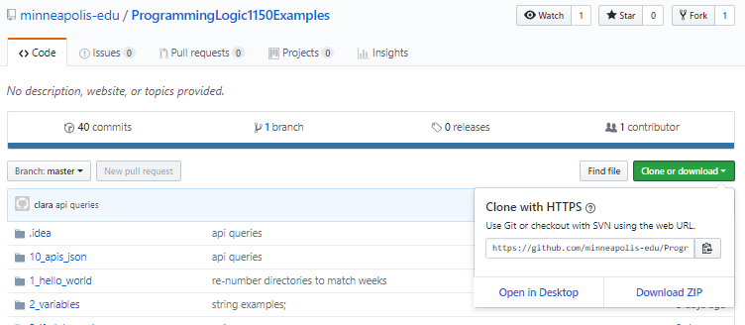
Code examples
https://github.com/minneapolis-edu/ProgrammingLogic1150Examples
Can download everything, or browse online. There will be updates and more examples added
It’s a PyCharm project so you can run all of the examples
Click green Clone or Download button
Click Download ZIP

Slide 5
This week
Flow control: making decisions with if elif else statements
len() function
Blocks in Python
Format Strings

Slide 6
Reminder –weather policy
If campus is open, we have class
If the weather is bad, then take care travelling
If you feel it is dangerous to travel, then stay home and work on the class materials at home. Slides and lab are in D2L. No penalty for missing class
If campus is closed, no class, schedule and due dates modified
Check our website before coming to class if the weather is bad to make sure we are open

Slide 7
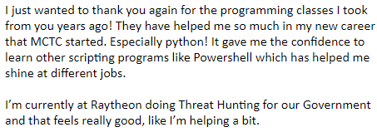
Python and information security
Network administrators, information security, forensics students: make sure you include Python on your resumes
Email from one of our graduates (yay!)

Slide 8
Flow Control - Making Decisions
Open PyCharm
Create a new project
Create a new Python file
See last week's slides for instructions

Slide 9
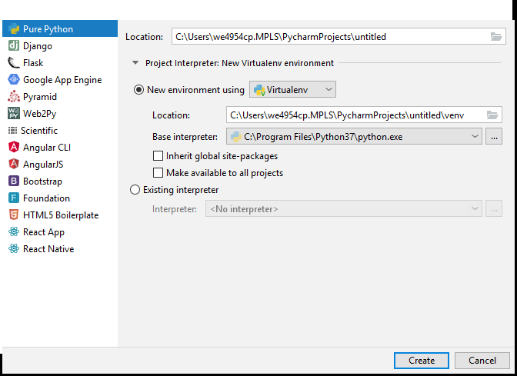
Verify Python version – should be 3.6 or 3.7
Click on the triangle on the left of
Project Interpreter: New Virtual Environment
Base interpreter should be a 3.6 or 3.7 version of Python

Slide 10
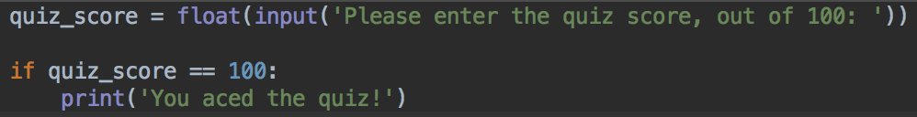
Is something equal to something else?
Quiz score program
Please start a new Python project, and enter this code
Notice that there are two == symbols on the second line
There's a : colon at the end of the second line
The third line starts with a tab
Run and test, enter 100
Run and test again, enter another number
What does the program do?

Slide 11
if statements
When you enter 100, quiz_score stores 100
The if quiz_score == 100: line checks to see if the quiz_score variable is equal to 100 or not
If it is equal, then the line that is indented will run
If it isn't equal, then the line that is indented will not run

Slide 12


if statements
If statements are made of a condition - something that can be True or False
And, some conditional code to run if (and only if) the condition is True

Slide 13


If statement syntax
if
condition
colon
Indent
Conditional code

Slide 14
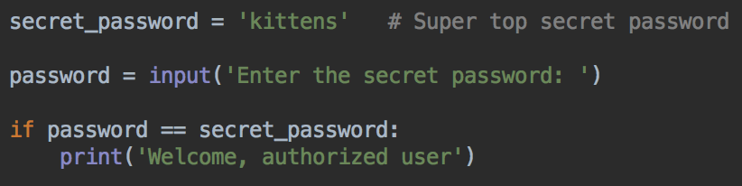


Checking if a string is equal
Create a new Python file
Write and test this password checking program

Slide 15
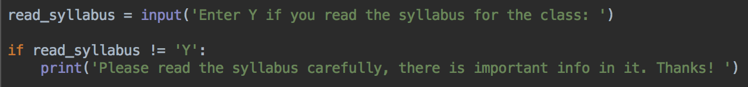
not equal !=
Use the != operator to check if something is NOT the same as something else

Slide 16
Writing conditions - comparison operators
Check if two things are equal with ==
Check if two things are not equal !=
Check if something is less than something else with <
Check if something is greater than something else with >
Check if something is less than or equal to something else with <=
Check if something is greater than or equal to something else with >=

Slide 17
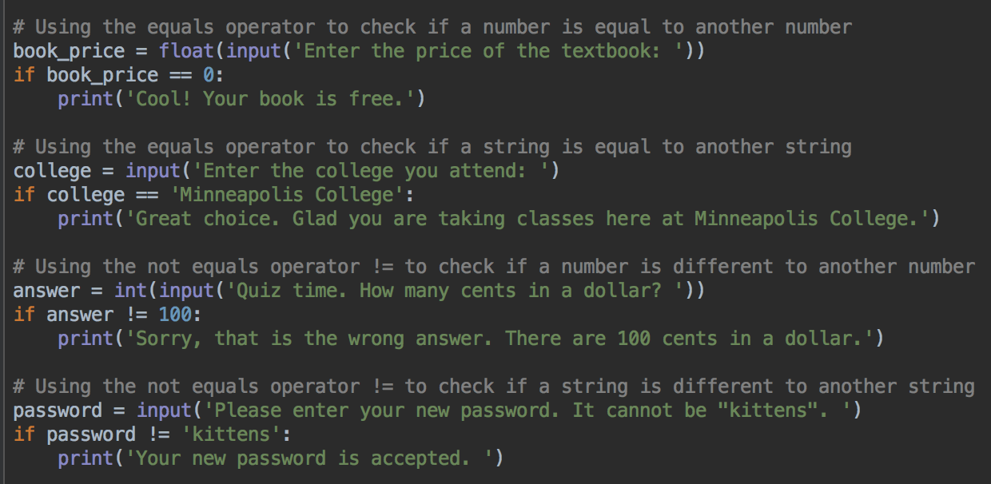
Comparison operators examples, == and !=

Slide 18
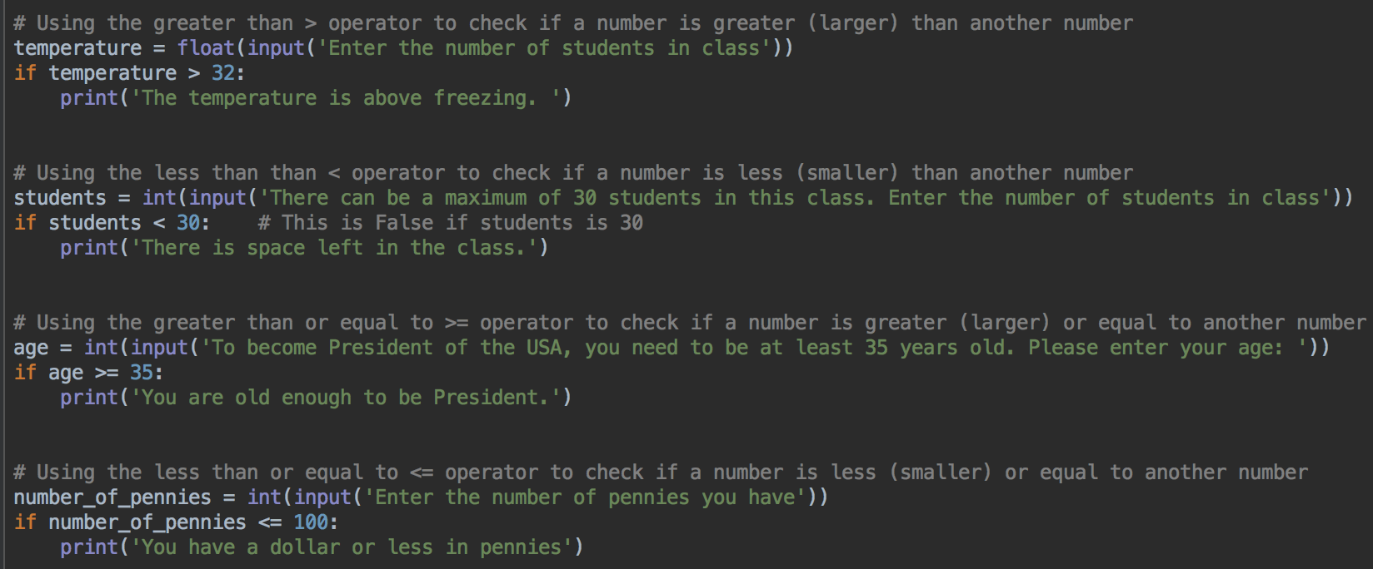
Comparison operators examples, < > <= >=

Slide 19
if else
Often, you want to do one thing if a condition is True, but do something else if it is False
For example, a password checking program needs to print a welcome message if the password is right, but print an error message if it is wrong
To do that, need to add an else block to an if statement

Slide 20
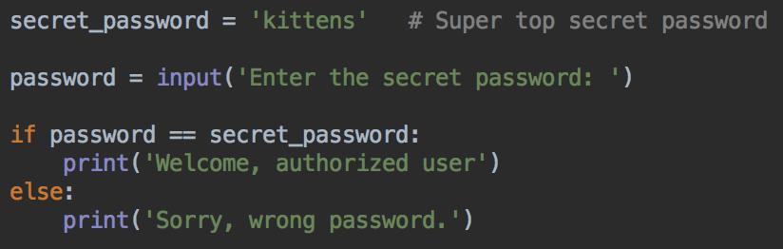
if else - password checker
Modify your password program to print a different message if the password is wrong
Watch the indentation and : after else

Slide 21


if else - password checker
Run and test password program
Try the right password - should see the welcome message
Try a wrong password - should see the error message

Slide 22
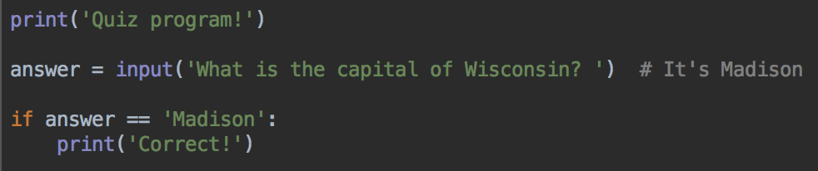
if else - quiz program
Start a new Python program
Enter this code
Run and test - should print the 'Correct!' message if the right answer is entered

Slide 23
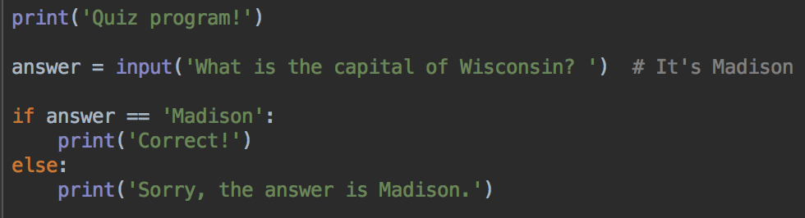
if - else quiz program
Add an else block to print a different message if the user enters the wrong answer
Run and test, verify the expected message is printed

Slide 24
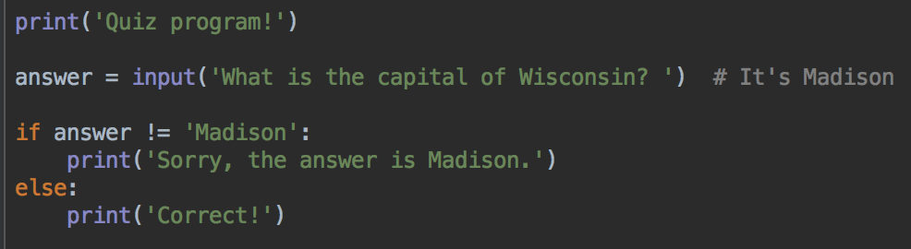
Many ways to express the same logic
This is exactly the same as the previous version of the quiz program
Uses the != operator to see if the answer is wrong

Slide 25
Is a student a full-time student?
When you file your taxes, you may get some tax advantages if you are a student, but it is important if you are full time, or not
Let's write a program to decide if a Minneapolis College student is a full-time student, or not

Slide 26
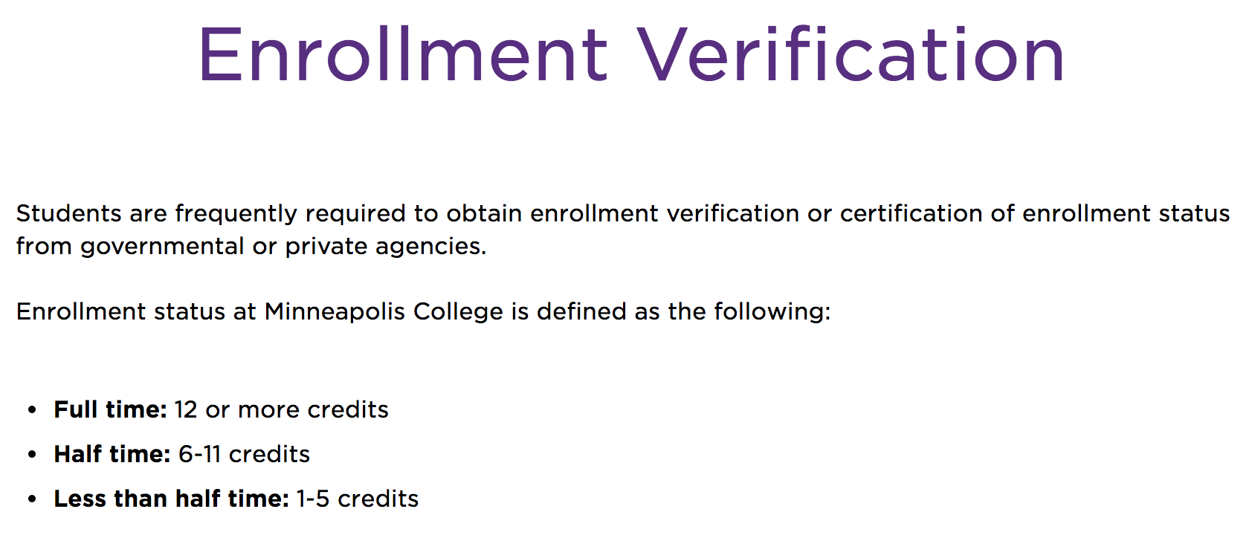
Program design!
Start by thinking about requirements
And data you need for the program
So, how does Minneapolis College define a full time student?
12 or more credits = full time
6 - 11 credits = half time
5 or less = less than half time
https://www.minneapolis.edu/student-services/registration-and-records/records/enrollment-verification

Slide 27
Requirements
Ask the user to enter the number of credits they are taking this semester
The program will decide if they are full time

Slide 28
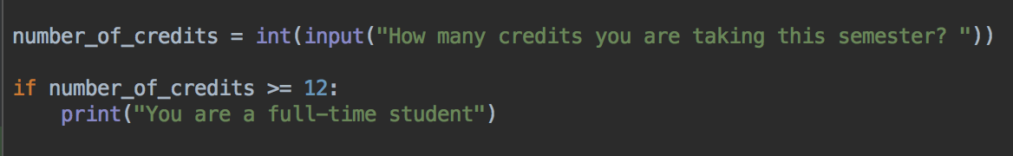
Code
In PyCharm, enter this code
Notice the 3rd line
print('You are a full-time student')
is tabbed (indented)
Run and test, enter some example data (e.g. 12, or 14)
Try running it again with some different example data (e.g. 0, or 5)

Slide 29
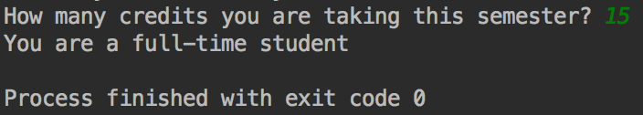
Example output
If you enter 15, should see the "You are a full-time" student message

Slide 30
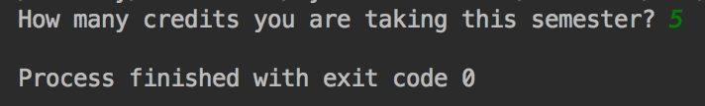
Try again, this time enter 5
No output, no message

Slide 31

Remember: If statements
Asking Python to check a condition
If that condition is true, execute some statements
If that condition is not true, don't execute the statements
This code says "if number_of_credits variable is greater or equal to 12, then print the message "You are a full-time student"

Slide 32
Not a full-time student?
Let's print a different message if the student is not a full time student
Perhaps we can use an else block?
But, there's more than one way to not be a full time student
We should have a message for half time and a different message for less than half time

Slide 33
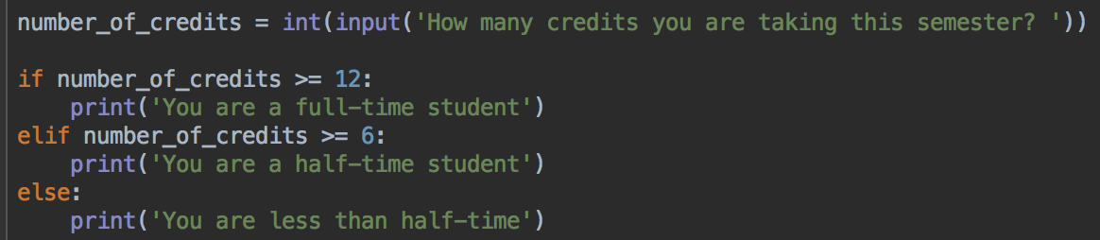


if - elif - else
Modify your program and add a elif and an else block
Run and test with different numbers

Slide 34
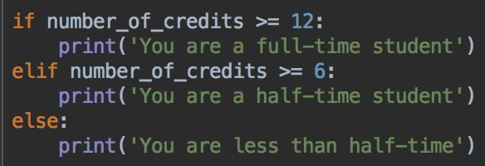
if - elif - else
If the if condition is true, run that conditional code
otherwise, check the elif condition. If the elif condition is true, run the elif conditional code
otherwise, run the conditional code for the else block
Check this
If not true, check this
Neither are true? run the else code

Slide 35
if - elif - else
Why doesn't the elif condition have to check that the number of credits is between 6 and 11?
Because if the if condition is true, the rest of the checks are skipped
So if the elif condition is being checked, the if condition must be false
So the number of credits can't be 12 or more
And the elif just needs to check if the number of credits is >= 6
Check this
If not true, check this
Neither are true? run the else code

Slide 36
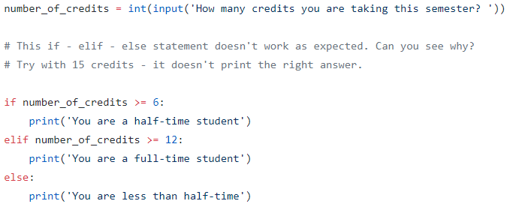

If – elif – else order matters
If you swap the order of the conditions, what happens?

Slide 37
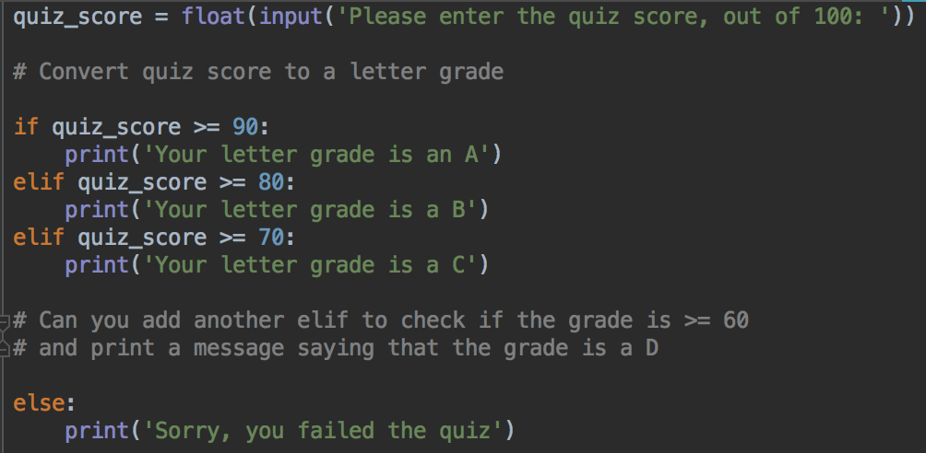
if elif else Letter grade calculator
Can you finish this program by adding the missing elif?

Slide 38
len()
Question - a program needs the user to enter their starID
A starID is 8 characters, for example, ab1234cd
How can we test if they entered the right number of characters?

Slide 39
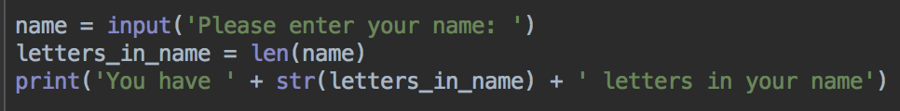

The len() function
Counts the number of characters in a string
Start a new python program
Enter this code, run and test. Is it counting the number of letters in your name correctly?

Slide 40
len()
The len function count the number of characters in a string, and return the number, as an int variable

Slide 41
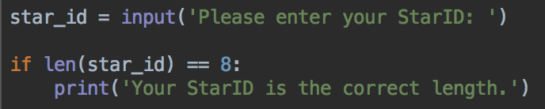
Putting it together
Start a new Python program
Enter this code
Run and test
Can you add an else block to print a different message if the StarID is the wrong length?
Can you modify your program to use an elif and else block to print different messages if the StarID is too long, or too short?

Slide 42
Checking more than one thing
Can check if more than one condition is true using the and operator
Check if at least one condition is true using the or operator

Slide 43
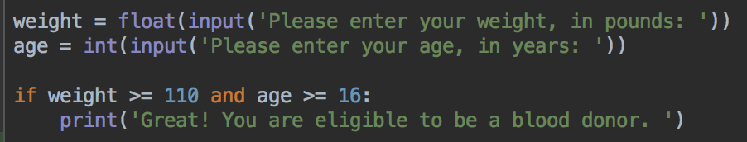
and
Does a person meet requirements to donate blood?
To donate blood, you must be at least 16 years old, and weigh at least 110 pounds

Slide 44
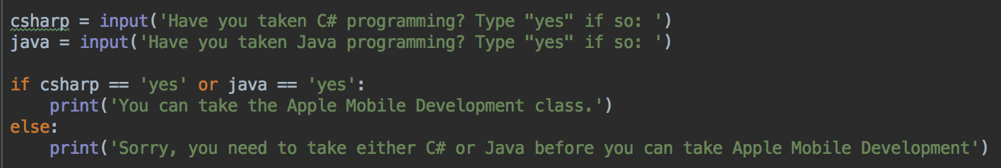
or
To take our Apple Mobile programming class, you have to take at least one of the pre-requisite classes, Java Programming or C# programming
So you have to take one or the other (or both)

Slide 45
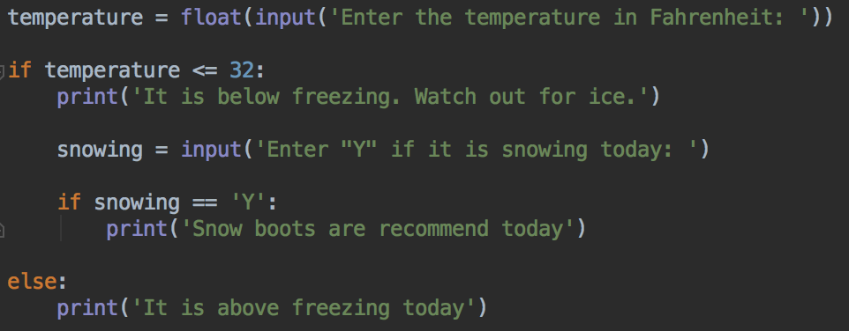
Nesting if statements
Can write if statements, and other code, inside an if, else or elif block

Slide 46
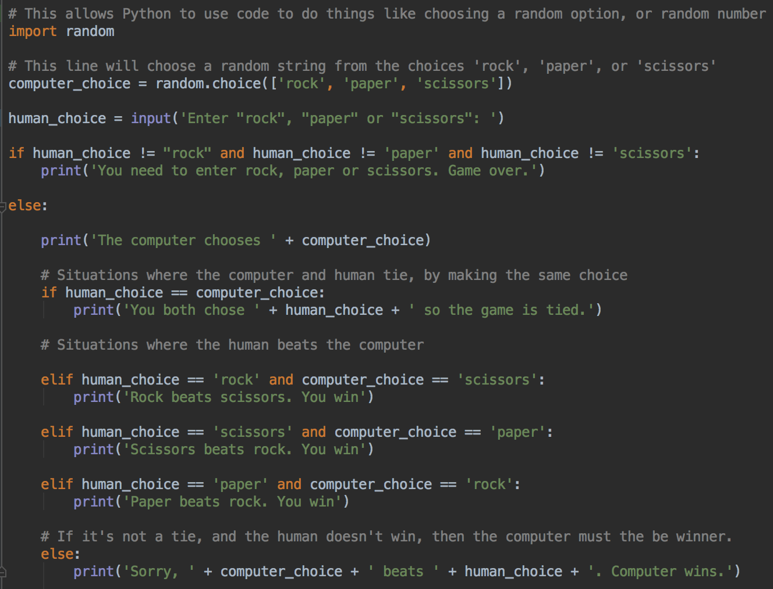
Rock, paper, scissors
Uses nested if statements
There's another if-elif-elif-elif-else inside the first if-else
Also making a random choice for the computer

Slide 47
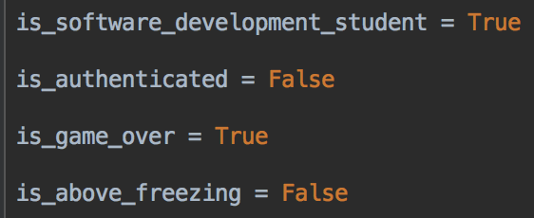
Boolean Values
We already know int, float, and str
Another data type is bool
bool is for storing Boolean values
A Boolean value is one of the two values True or False

Slide 48
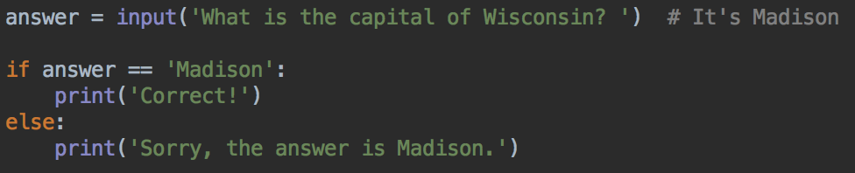
Using bool variables in if statements
Remember that an if or elif statement has a condition
Python will check the condition and decide if it is True or False
And then, that decides which code to run

Slide 49
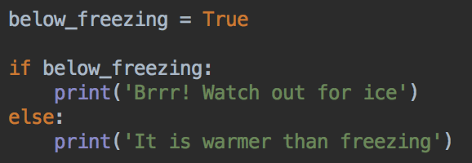
So, we can use a Boolean value in a condition
For example,
It is correct Python to write the condition as below_freezing == True but it's more typing. The version above is preferred.

Slide 50
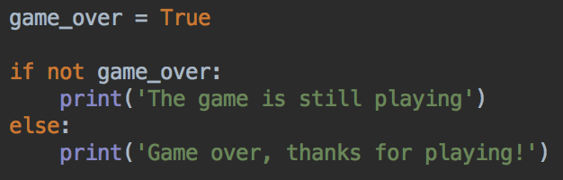
Checking if a Boolean is false with not
It is correct Python to write the condition as game_over == False but it's more typing. not game_over is preferred.

Slide 51
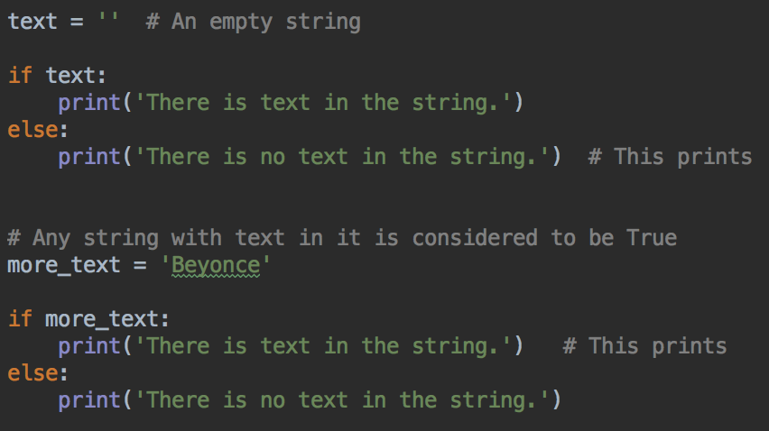
Truthy and Falsy values
Empty strings are considered to be false, strings with at least one character are true

Slide 52
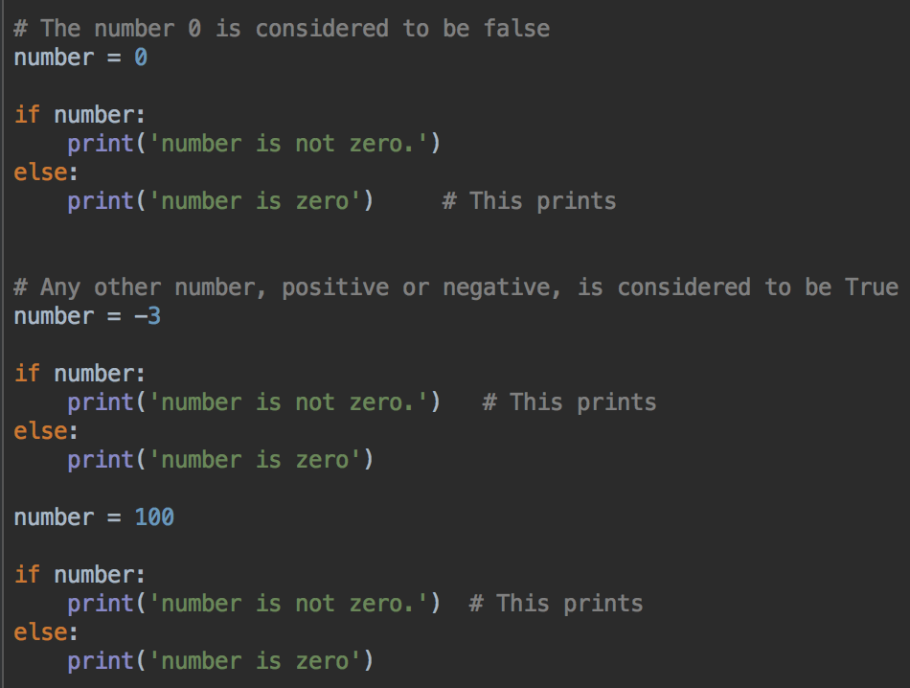
Truthy and Falsy values
The number 0 is considered to be false, any other number is true

Slide 53
Lab 3
In D2L
Write the programs
Start now, if time, finish at home
Submit your programs to Lab 3 assignment dropbox before next class
Questions? Need help? Ask me, or one of the tutors

